Slide 1
Floor Planning/Bin Packing

Slide 2
Blank Slide

Slide 3
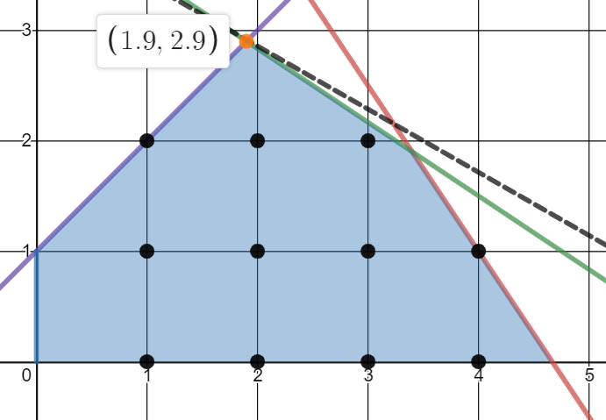
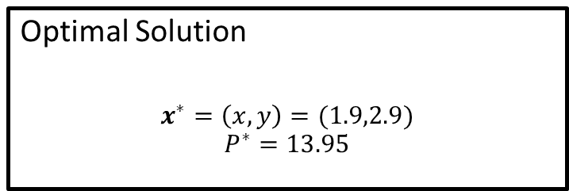


Linear Program
maximise $P=2x+3.5y$
subject to:
$$3x+2y≤14 \\ 2x+3y≤12.5 \\ −x+y≤1$$
and
$x,y≥0$
$$P=2x+3.5y$$
Optimal Solution
$$x^{∗}=\left(x,y\right)=(1.9,2.9)$$
$$P^{∗}=13.95$$

Slide 4
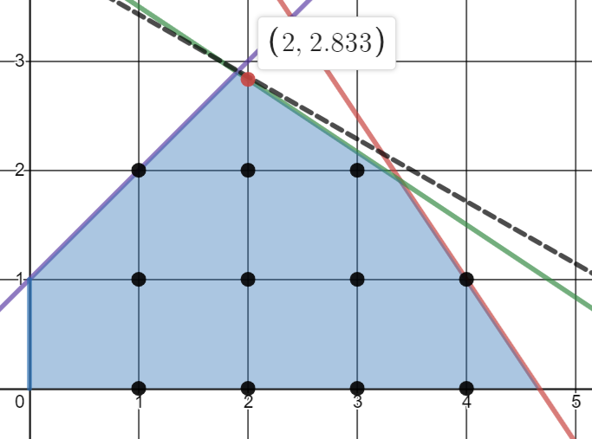


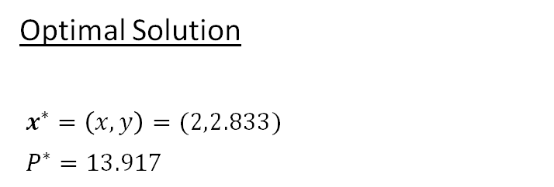
Mixed-Integer Program
maximise $P=2x+3.5y$
subject to:
$$3x+2y≤14 \\ 2x+3y≤12.5 \\ −x+y≤1$$
and
$x,y≥0$
$x∈ℤ$
$$P=2x+3.5y$$
Optimal Solution
$x^{∗}=\left(x,y\right)=(2,2.833)$
$P^{∗}=13.917$

Slide 5
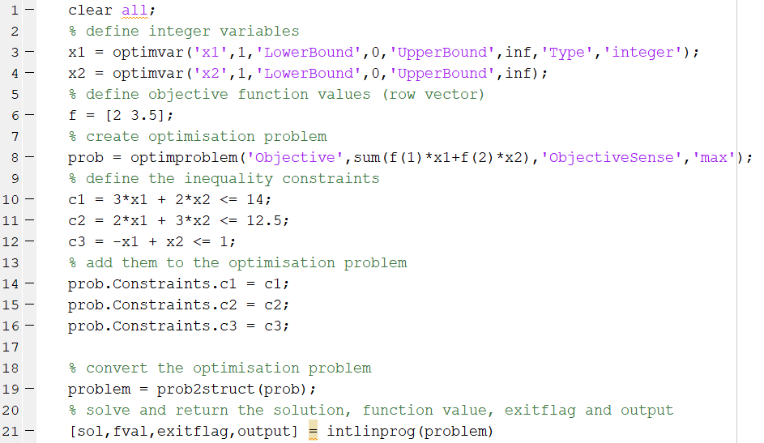
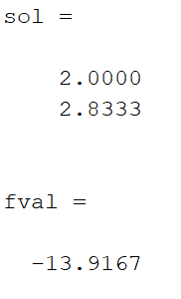
Mixed-Integer Solution (problem based)
maximise $P=2x+3.5y$
subject to:
$$3x+2y≤14 \\ 2x+3y≤12.5 \\ −x+y≤1$$
and
$x,y≥0$
$x∈ℤ$
Optimal Solution
$x^{∗}=\left(x,y\right)=(2,2.833)$
$P^{∗}=13.917$

Slide 6
2 Dimensional Floor Planning

Slide 7
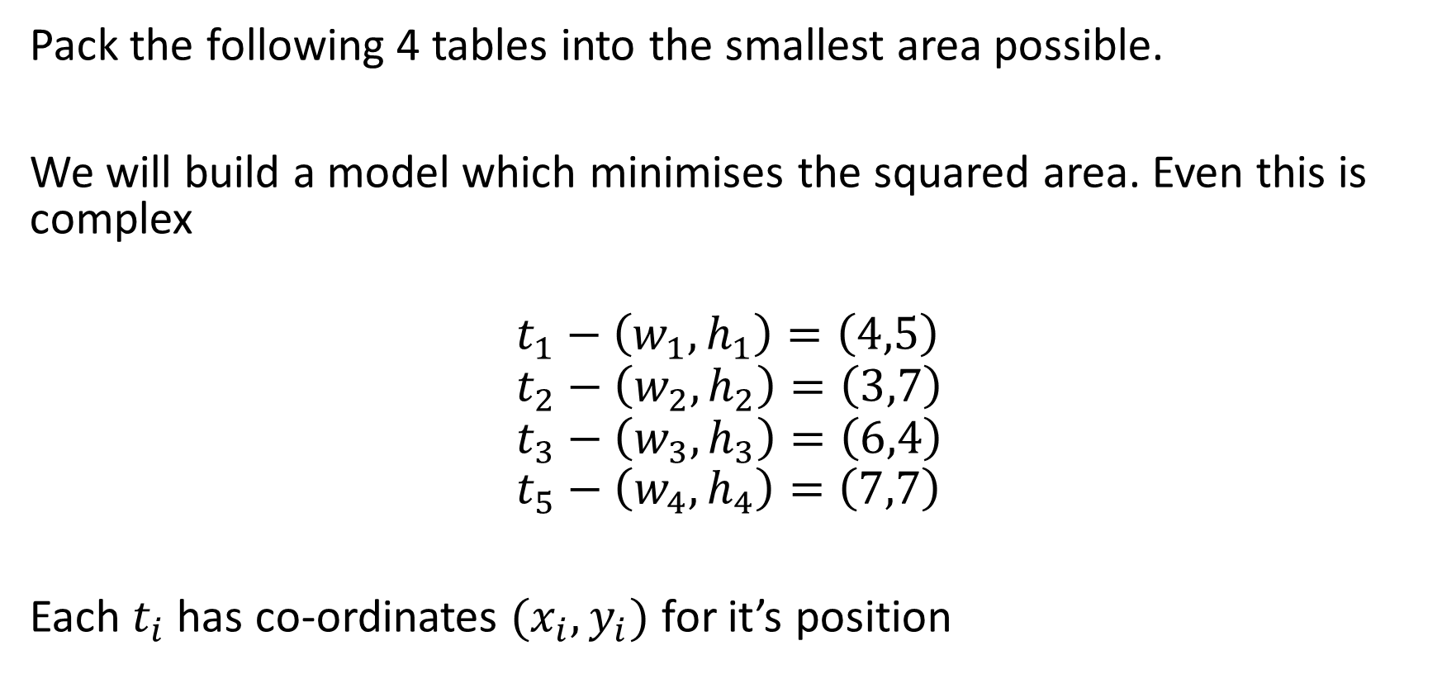
Floor Planning
Pack the following 4 tables into the smallest area possible.
We will build a model which minimises the squared area. Even this is complex
$$t_{1}−\left(w_{1},h_{1}\right)=\left(4,5\right) \\ t_{2}−\left(w_{2},h_{2}\right)=\left(3,7\right) \\ t_{3}−\left(w_{3},h_{3}\right)=\left(6,4\right) \\ t_{5}−\left(w_{4},h_{4}\right)=\left(7,7\right)$$
Each $t_{i}$ has co-ordinates $(x_{i}, y_{i})$ for it’s position

Slide 8





Floor Planning
$$t_{1}−\left(w_{1},h_{1}\right)=\left(4,5\right) \\ t_{2}−\left(w_{2},h_{2}\right)=\left(3,7\right) \\ t_{3}−\left(w_{3},h_{3}\right)=\left(6,4\right) \\ t_{5}−\left(w_{4},h_{4}\right)=\left(7,7\right)$$
Each $t_{i}$ has:
co-ordinates $\left(x_{i}, y_{i}\right)$
Width - $w_{i}$
Height - $h_{i}$
$$t_{i}$$
$$h_{i}$$
.
$$\left(x_{i}, y_{i}\right)$$
$$w_{i}$$

Slide 9
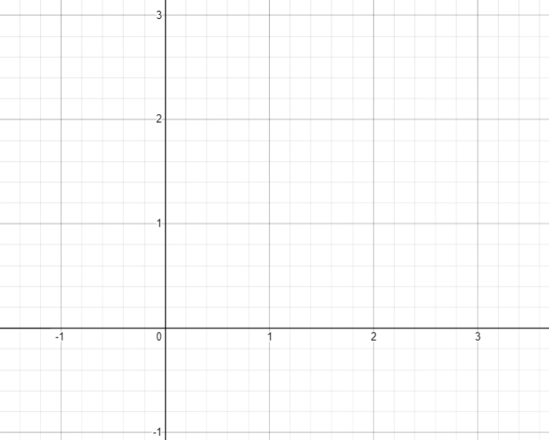








Non-overlapping constraints
$$t_{2}$$
Make sure that the tables don’t overlap.
Consider table $t_{1}$ and table $t_{2}$
Either
$$x_{1}+w_{1}≤x_{2}$$
Or
$$x_{2}+w_{2}≤x_{1}$$
Only one can hold!
$$t_{1}$$
$$t_{2}$$
$$t_{1}$$
$$t_{2}$$
$$t_{1}$$

Slide 10



Intuition – 4 possible situations
$$x_{1}+w_{1}≤x_{2}$$
$$t_{2}$$
$$t_{1}$$

Slide 11


Intuition – 4 possible situations
$$x_{2}+w_{2}≤x_{1}$$
$$t_{2}$$
$$t_{1}$$

Slide 12

Intuition – 4 possible situations
$$y_{1}+h_{1}≤y_{2}$$
$$t_{2}$$
$$t_{1}$$

Slide 13


Intuition – 4 possible situations
$$y_{2}+h_{2}≤y_{1}$$
$$t_{1}$$
$$t_{2}$$

Slide 14

Non-overlapping constraints
In fact for the 4 constraints, only one need hold to allow for all locations that don’t overlap!
Either
$$x_{1}+w_{1}≤x_{2}$$
Or
$$x_{2}+w_{2}≤x_{1}$$
Or
$$y_{1}+h_{1}≤y_{2}$$
Or
$$y_{2}+h_{2}≤y_{1}$$

Slide 15
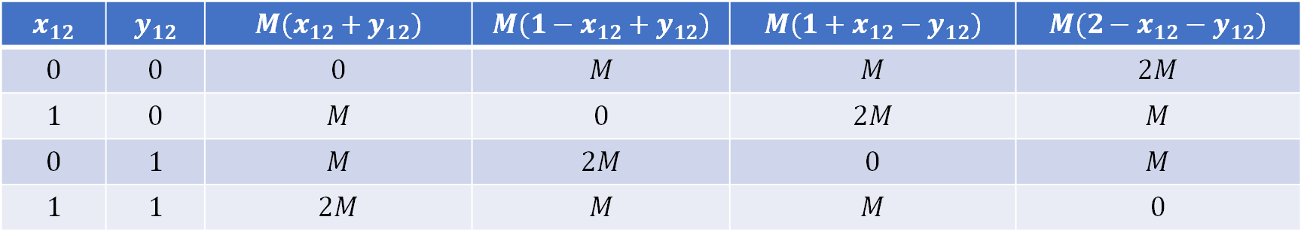

Binary Variables
Introduce binary variables for the two tables
$$x_{12},y_{12}∈\left\{0,1\right\}$$
We can use these to only consider one constraint, let $M$ be a sufficiently large number
$$x_{12}$$ | $$y_{12}$$ | $$M(x_{12}+y_{12})$$ | $$M(1−x_{12}+y_{12})$$ | $$M(1+x_{12}−y_{12})$$ | $${M(2−x}_{12}−y_{12})$$
$$0$$ | $$0$$ | $$0$$ | $$M$$ | $$M$$ | $$2M$$
$$1$$ | $$0$$ | $$M$$ | $$0$$ | $$2M$$ | $$M$$
$$0$$ | $$1$$ | $$M$$ | $$2M$$ | $$0$$ | $$M$$
$$1$$ | $$1$$ | $$2M$$ | $$M$$ | $$M$$ | $$0$$

Slide 16
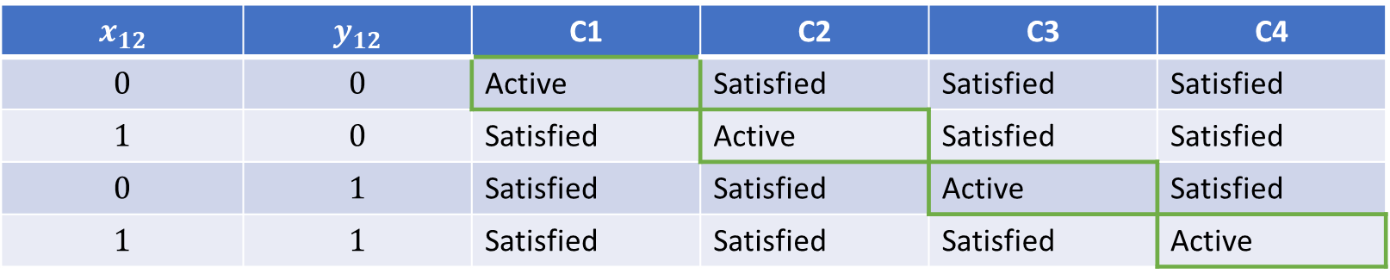

Non-overlapping constraints
Our 4 constraints for table 1 and 2 are now
$$x_{1}+w_{1}≤x_{2}+M(x_{12}+y_{12})$$
$$x_{2}+w_{2}≤x_{1}+M(1−x_{12}+y_{12})$$
$$y_{1}+h_{1}≤y_{2}+M(1+x_{12}−y_{12})$$
$$y_{2}+h_{2}≤y_{1}+M(2−x_{12}−y_{12})$$
$$x_{12}$$ | $$y_{12}$$ | C1 | C2 | C3 | C4
$$0$$ | $$0$$ | Active | Satisfied | Satisfied | Satisfied
$$1$$ | $$0$$ | Satisfied | Active | Satisfied | Satisfied
$$0$$ | $$1$$ | Satisfied | Satisfied | Active | Satisfied
$$1$$ | $$1$$ | Satisfied | Satisfied | Satisfied | Active

Slide 17

Non-overlapping constraints
How many non overlapping constraints?
Test each pair. Given $n$ items (tables)
$$4⋅\left(\begin{matrix}n \\ 2\end{matrix}\right)$$
This is a combinatorial problem!

Slide 18

Objective
For all $i$ (every table)
$$x_{i}+w_{i}≤A^{∗}$$
$$y_{i}+h_{i}≤A^{∗}$$
Then
minimise $A^{∗}$
This is a know as a minimax problem. That is, we wish to minimise the upper $A^{∗}$ bound of the constraints

Slide 19

MILP Formulation
minimise $A^{∗}$
subject to:
For all $i$ (every table)
$$x_{i}+w_{i}≤A^{∗}$$
$$y_{i}+h_{i}≤A^{∗}$$
For all $i,j$, $i<j$ (all pairs, don’t check twice)
$$x_{i}+w_{i}≤x_{j}+M(x_{ij}+y_{ij})$$
$$x_{j}+w_{j}≤x_{i}+M(1−x_{ij}+y_{ij})$$
$$y_{i}+h_{i}≤y_{j}+M(1+x_{ij}−y_{ij})$$
$$y_{j}+h_{j}≤y_{i}+M\left(2−x_{ij}−y_{ij}\right)$$
$$x_{ij},y_{ij}∈\{0,1\}$$
$$x_{i},y_{i}≥0$$
MiniMax Constraint
Non overlapping constraints
Variable constraints

Slide 20
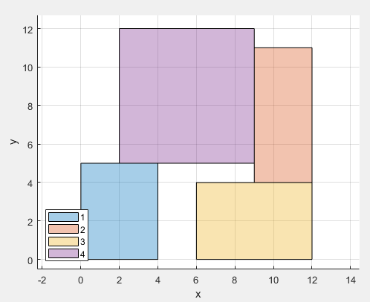
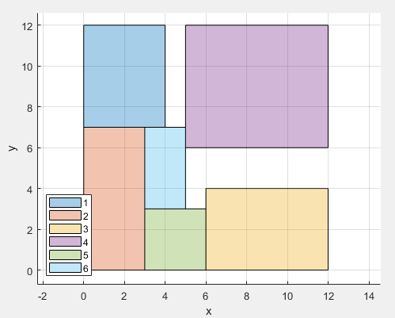
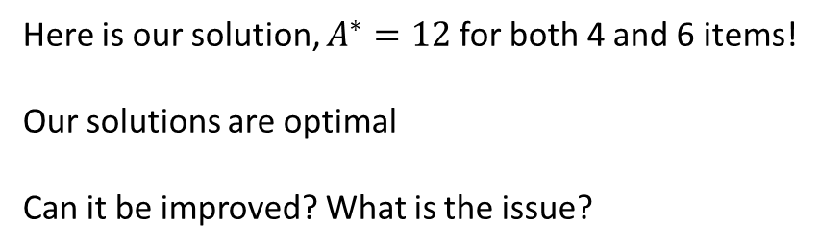
Solution
Here is our solution, $A^{∗}=12$ for both 4 and 6 items!
Our solutions are optimal
Can it be improved? What is the issue?

Slide 21
Adding Rotation

Slide 22








Floor Planning
On rotation width and height is swapped
$$t_{i}$$
$$t_{i}$$
$$w_{i}$$
$$h_{i}$$
.
.
$$\left(x_{i}, y_{i}\right)$$
$$\left(x_{i}, y_{i}\right)$$
$$w_{i}$$
$$h_{i}$$

Slide 23

Amending the constraints
Introduce binary variables $r_{i}$. $r_{i}=0$ (not rotated), $r_{i}=1$ (rotated).
Minimax constraints
For all $i$ (every table)
$$x_{i}{+(1−r_{i})w}_{i}+r_{i}h_{i}≤A^{∗}$$
$$y_{i}+{\left(1−r_{i}\right)h}_{i}+r_{i}w_{i}≤A^{∗}$$
Non overlapping constraints
For all $i,j$, $i<j$ (all pairs, don’t check twice)
$$x_{i}{+(1−r_{i})w}_{i}+r_{i}h_{i}≤x_{j}+M(x_{ij}+y_{ij})$$
$$x_{j}+{(1−r_{j})w}_{j} + r_{j}h_{j}≤x_{i}+M(1−x_{ij}+y_{ij})$$
$$y_{i}+{\left(1−r_{i}\right)h}_{i} + r_{i}w_{i}≤y_{j}+M(1+x_{ij}−y_{ij})$$
$$y_{j}+{\left(1−r_{j}\right)h}_{j} + r_{j}w_{j}≤y_{i}+M\left(2−x_{ij}−y_{ij}\right)$$

Slide 24
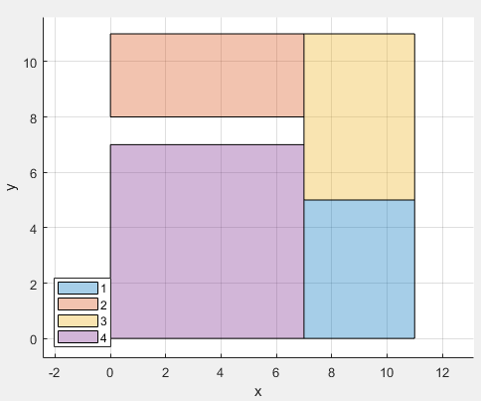

Solution
Here is our solution, $A^{∗}=11$. Improvement!
Can it be improved? This is dependent on your desired objective!

Slide 25
Connected 2 Dimensional Packing
Minimisation of the rectilinear distance between connected items

Slide 26




Clustering of components
Perhaps you have connected components that need to be close to each other and you have a fixed width/height for your floor space.
$$t_{2}$$
$$t_{3}$$
$$t_{1}$$
$$t_{4}$$

Slide 27
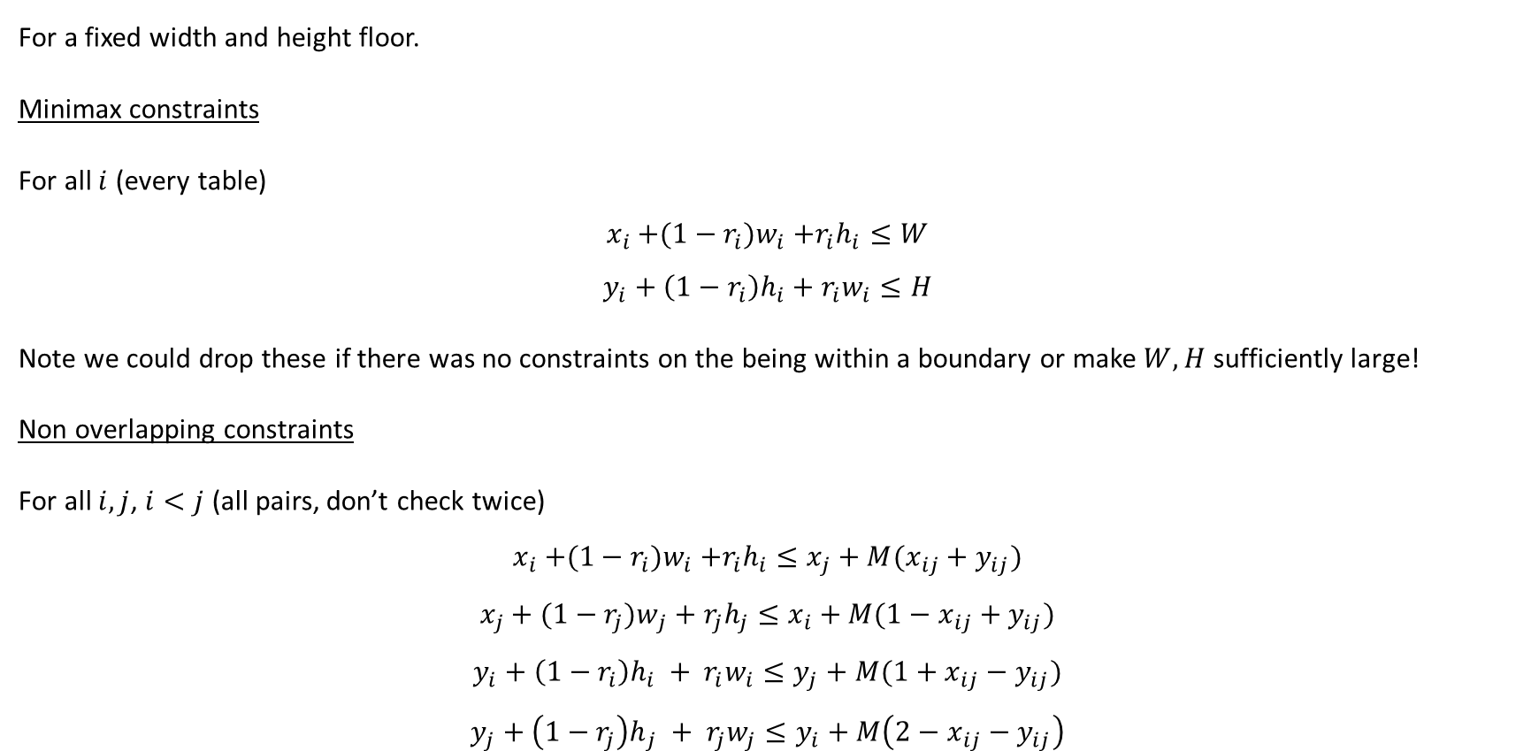
Amending the constraints
For a fixed width and height floor.
Minimax constraints
For all $i$ (every table)
$$x_{i}{+(1−r_{i})w}_{i}+r_{i}h_{i}≤W$$
$$y_{i}+{\left(1−r_{i}\right)h}_{i}+r_{i}w_{i}≤H$$
Note we could drop these if there was no constraints on the being within a boundary or make $W,H$ sufficiently large!
Non overlapping constraints
For all $i,j$, $i<j$ (all pairs, don’t check twice)
$$x_{i}{+(1−r_{i})w}_{i}+r_{i}h_{i}≤x_{j}+M(x_{ij}+y_{ij})$$
$$x_{j}+{(1−r_{j})w}_{j} + r_{j}h_{j}≤x_{i}+M(1−x_{ij}+y_{ij})$$
$$y_{i}+{\left(1−r_{i}\right)h}_{i} + r_{i}w_{i}≤y_{j}+M(1+x_{ij}−y_{ij})$$
$$y_{j}+{\left(1−r_{j}\right)h}_{j} + r_{j}w_{j}≤y_{i}+M\left(2−x_{ij}−y_{ij}\right)$$

Slide 28
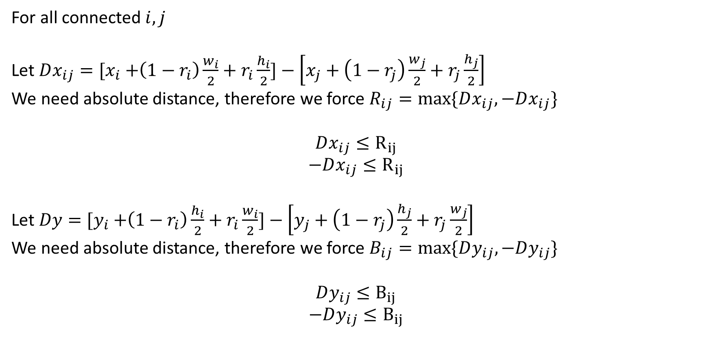
Distance between items (from centre points)
For all connected $i,j$
Let $Dx_{ij}={[x}_{i} +\left(1−r_{i}\right)\frac{w_{i}}{2}+r_{i}\frac{h_{i}}{2}]−\left[x_{j}+\left(1−r_{j}\right)\frac{w_{j}}{2}+r_{j}\frac{h_{j}}{2}\right]$
We need absolute distance, therefore we force $R_{ij}=max⁡\{Dx_{ij},−Dx_{ij}\}$
$$Dx_{ij}≤R_{ij}$$
$$−Dx_{ij}≤R_{ij}$$
Let $Dy={[y}_{i} +\left(1−r_{i}\right)\frac{h_{i}}{2}+r_{i}\frac{w_{i}}{2}]−\left[y_{j}+\left(1−r_{j}\right)\frac{h_{j}}{2}+r_{j}\frac{w_{j}}{2}\right]$
We need absolute distance, therefore we force $B_{ij}=max⁡\{Dy_{ij},−Dy_{ij}\}$
$$Dy_{ij}≤B_{ij}$$
$$−Dy_{ij}≤B_{ij}$$

Slide 29

Objective Function
Minimise Rectilinear Distance
For all connected $i,j$
Min $\sum_{i}{\sum_{j}{(R_{ij}+B_{ij})}}$

Slide 30
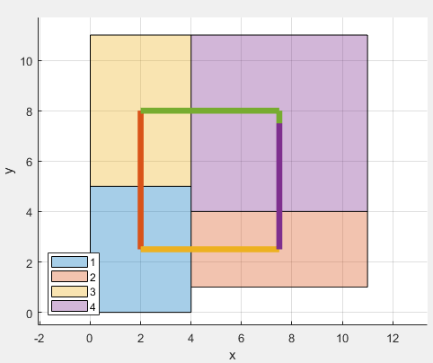
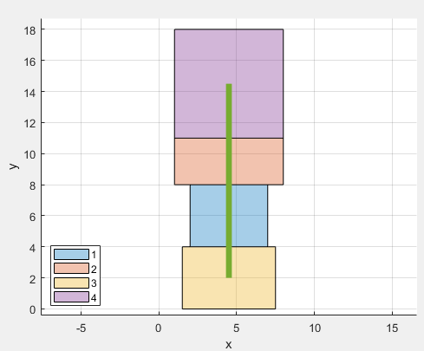
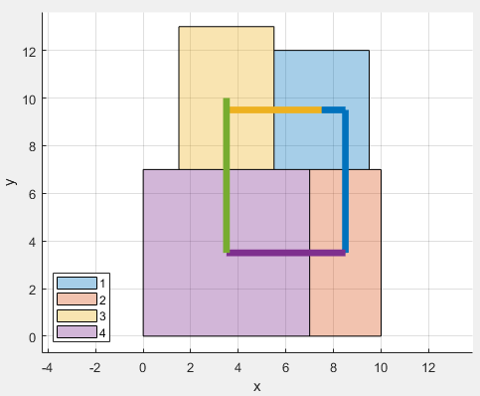



Results for different floor spaces
$$W=20, H=20$$
$$W=8, H=20$$
$$W=10, H=15$$

Slide 31
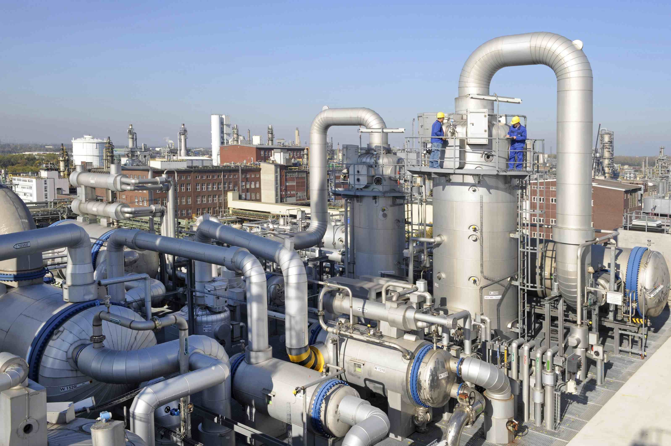
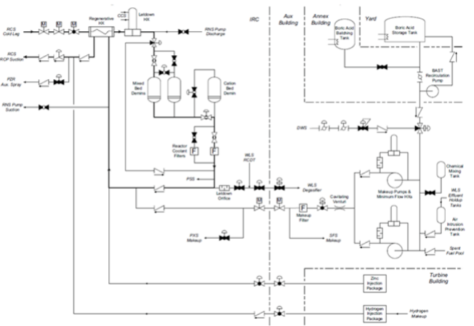
Problem

Slide 32
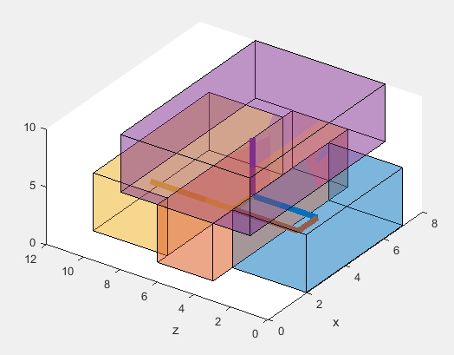
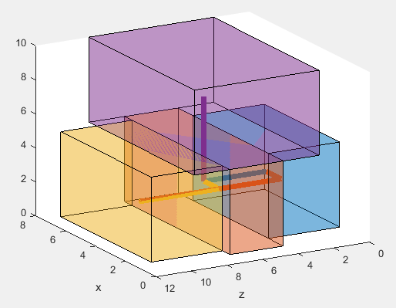
Example Solution
This is a simplified plot, the boxes contain enough space to include the piping.
It also requires structures to support items off the floor!

Slide 33

Returning to our simple packing problem
minimise $A^{∗}$
subject to:
For all $i$ (every table)
$$x_{i}{+(1−r_{i})w}_{i}+r_{i}h_{i}≤A^{∗}$$
$$y_{i}+{\left(1−r_{i}\right)h}_{i}+r_{i}w_{i}≤A^{∗}$$
For all $i,j$, $i<j$ (all pairs, don’t check twice)
$$x_{i}{+(1−r_{i})w}_{i}+r_{i}h_{i}≤x_{j}+M(x_{ij}+y_{ij})$$
$$x_{j}+{(1−r_{j})w}_{j} + r_{j}h_{j}≤x_{i}+M(1−x_{ij}+y_{ij})$$
$$y_{i}+{\left(1−r_{i}\right)h}_{i} + r_{i}w_{i}≤y_{j}+M(1+x_{ij}−y_{ij})$$
$$y_{j}+{\left(1−r_{j}\right)h}_{j} + r_{j}w_{j}≤y_{i}+M\left(2−x_{ij}−y_{ij}\right)$$
$$x_{ij},y_{ij}∈\{0,1\}$$
$$x_{i},y_{i}≥0$$
MiniMax Constraint
Non overlapping constraints
Variable constraints

Slide 34
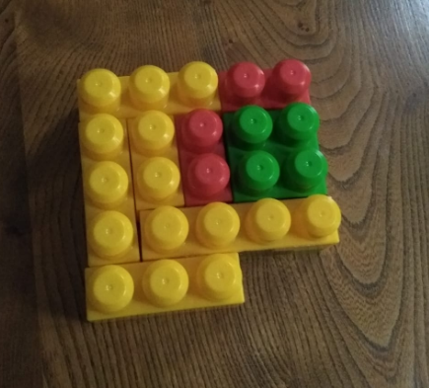
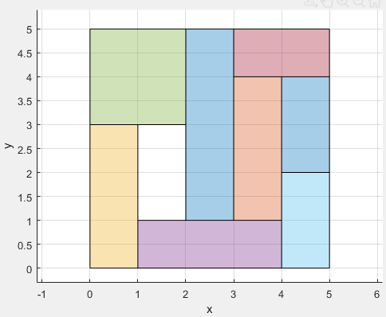
Mums Know Best!
Approximately 10 minutes!
4,936,427 solutions explored
Note that the optimal was actually found in 0.6 seconds, but the program doesn’t know it’s optimal
Approximately 20 seconds
Approximately 4 solutions explored

Slide 35

Why so inefficient?
Binary variables.
$x_{ij},y_{ij}$ exist for every pair of items
$$2⋅\left(\begin{aligned}n \\ 2\end{aligned}\right)$$
Each can have a value of $\{0,1\}$
$$2^{2⋅\left(\begin{aligned}n \\ 2\end{aligned}\right)}$$
For 7 items that is…
$$2^{2⋅\left(\begin{aligned}7 \\ 2\end{aligned}\right)}≈4.4×{10}^{12}$$
For 10 items to explore every solution every millisecond this would take you
$39228790500000000$ years!

Slide 36


Conclusion
How does Santa pack his sleigh?
NP-Hard Optimisation!
Or By Magic!

